Slide 1
MASK AND SOCIAL DISTANCING DETECTION

Slide 2
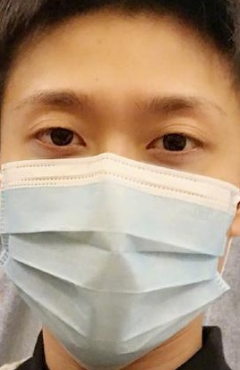
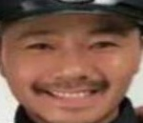
Dataset Details :
Face Mask Detection :
The dataset consists of 4092 images.
With_Mask : 2162 images
Without_Mask : 1932 images
The images are resized to 224 x 224 x 3 and the input pixel values are scaled between -1 and 1.
The data is split into 80% for training and remaining 20% for testing.
Additional data augmentation is done on the following parameters :
rotation_range
zoom_range
width_shift_range
height_shift_range
shear_range
horizontal_flip
fill_mode
Without Mask
With Mask

Slide 3
Model Details :
PART 1
Load Face Mask dataset
Train Face Mask Detector using MobileNet V2
Face Mask Detector Model
PART 2
Bounding Box locations of faces present
Face Mask Detector Model
(Part 1)
Input Frame
Face Detection using DNN
Mask or No Mask for faces Respectively

Slide 4
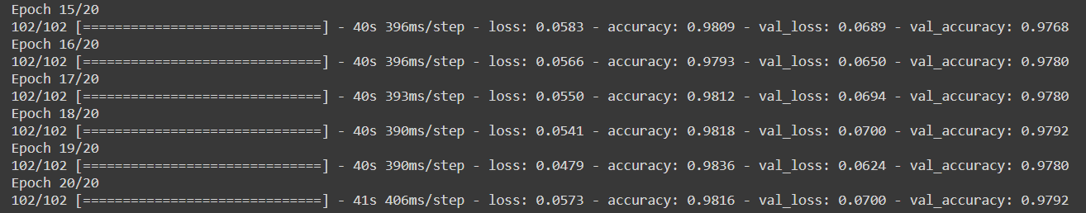
Model Details :
Input Shape : 224 x 224 x 3
Number Of Layers : 159
Trainable Parameters : 164,226
Size of Model after saving as a .hdf5 file : 12 MB
This small size makes it easier for the model to be deployable on most of the platforms with ease.
Number of epochs : 20

Slide 5
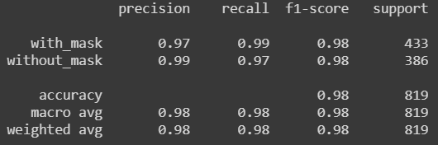
Accuracy :
The final accuracy of the mask detection model is : 98%

Slide 6
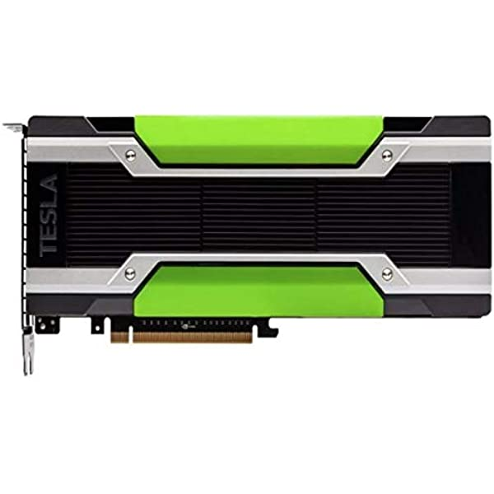
GPU Details :
The model has been trained on the Google Colab platform.
The GPU used in the runtime is : Tesla K80
Memory of GPU used : 4.84 GB
Time taken to train the model on the GPU : Each epoch in the model takes an average of 42.65 seconds to complete 102 steps. Total Time Taken : 853 seconds 14 minutes
Without a GPU, each epoch took a minimum of 2 minutes to complete the same 102 steps.

Slide 7
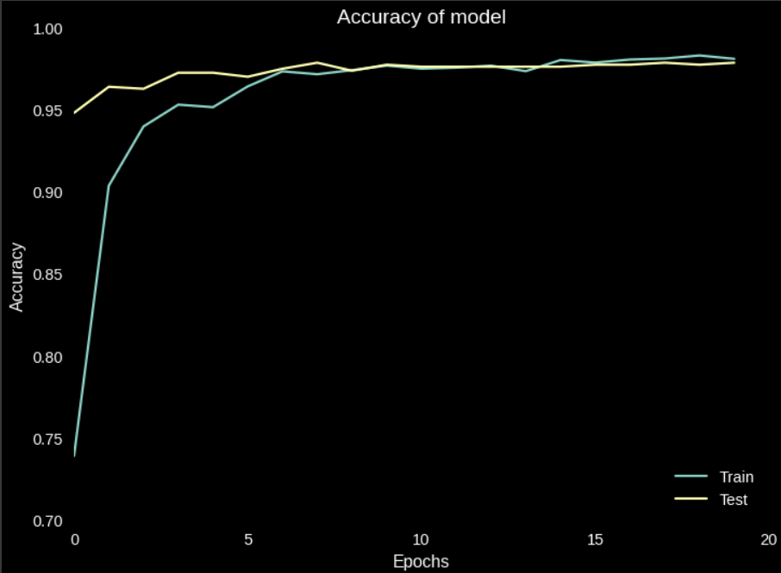
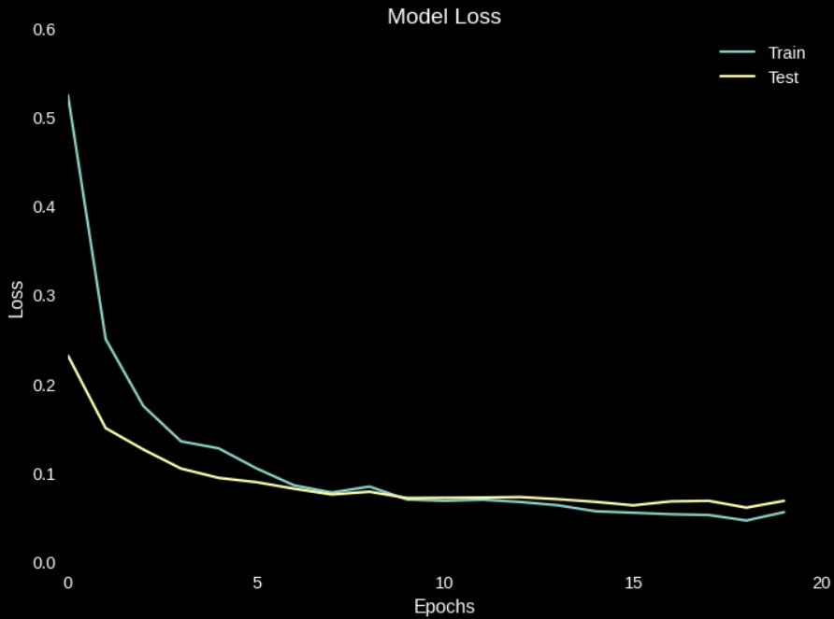
Performance Details :
Optimizer Used : Adam (Learning Rate = 0.0001)
For performance tweaks, different optimizers like Adamax, Adagrad etc. were used, but ADAM optimizer gave the highest accuracy .
Loss Function : Different combinations of loss functions and activation functions in last layers were tested : like , binary_crossentropy and sigmoid , categorical_crossentropy and softmax. Out of which the latter gave the higher accuracy.

Slide 8
Social Distancing :
Finding distance b/w people wrt threshold.
Bounding Box locations of faces present
Finding centroids
(for each boxes)
Input Frame
Face Detection using DNN
Centroids for boxes Respectively
Threshold
Green and Red Boxes for respective distances
Near and Not Near for faces Respectively
Finding Violating Points
Finding Euclidean distance
(from each centroid)

Slide 9
Combination of the above :
The face mask detection model and the estimation of distance between people have been combined to give the user a risk level based on the parameters.
If a person is alone and not wearing a mask, No Risk , will be shown.
If more than one person :
If both are apart and wearing a mask ,Low Risk , will be shown.
If both are near and wearing a mask , Risk , will be shown.
If both are apart and not wearing a mask , Risk , will be shown.
If both are near and not wearing a mask ,High Risk , will be shown.

Slide 10
Combination of the above Model :
Input Frame
Face Detection using DNN
Bounding Box locations for each faces
Mask or No Mask for faces Respectively
Face Mask Detector Model
(Part 1)
Low Risk
Risk
High Risk
labelling
Threshold
Near and Not Near for faces Respectively
Finding Violating Points
Finding centroids
(for each boxes)
Centroids for boxes Respectively
Finding Euclidean distance
(from each centroid)

Slide 11
SIMULATION IN LAPTOP

Slide 12
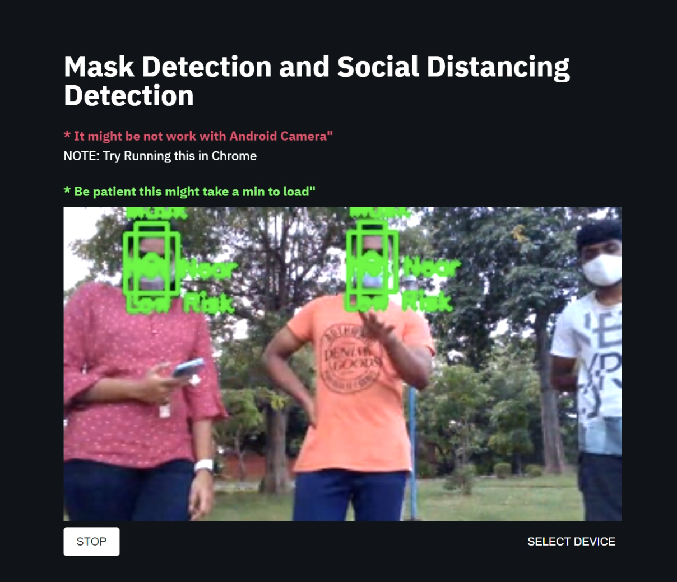
WEB APP:
This Algorithm is Deployed using streamlit package.
This App is deployed on streamlit share and hosted publicly on GitHub.
Link for Web App
https://share.streamlit.io/kabilan-n/face-detection-and-social-distancing/main/Streamlit/mask_det_app.py

Slide 13
What we learnt :
Gained knowledge on how to deploy an end to end model with the help of streamlit services.
Application of mathematics in real life problems (Euclidean distance is used to find distance between people)
Deep Neural Networks. In this case we learned about mobilenet which uses depth-wise separable convolutions.
Use of pre trained weights of ImageNet to further improve accuracy of our model using Transfer Learning.
Reducing the number of processes or workload on the system.
It is not necessary to always build or train a model in order to make a prediction, in the case of finding distance between two people, no model is used.

Slide 14
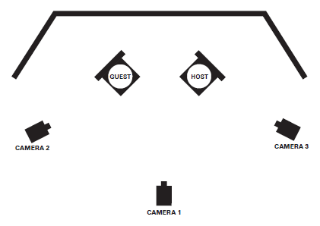

Future Work :
Deployment of the complete model using multiple cameras at different locations, to obtain inputs from different directions.
Notifying the person captured in the camera (Access to public database is needed), as well as authorities.
Using heat sensors to detect a relation between the temperature and the known factors to provide a more accurate risk value.
With the knowledge of risk in various areas, creating a path or a route that has the least risk possible.

Slide 15
Links :
Web App
https://share.streamlit.io/kabilan-n/face-detection-and-social-distancing/main/Streamlit/mask_det_app.py
Web App Github page
Face-Detection-and-social-Distancing/Streamlit at main · Kabilan-n/Face-Detection-and-social-Distancing · GitHub
IPYNB file
https://github.com/Adhithan007/Mask-Detection-and-Social-Distancing/blob/main/maskandpositionfacenet.ipynb
Test Video:
https://drive.google.com/file/d/14AMs4ockT6Cp-Q5bevdXSYH_GDgLqb9x/view?usp=sharing

Slide 16
Thank You

